Slide 1
VEINS OF LOWER LIMB
Dr Omotayo H A

Slide 2
VEINS OF LOWER LIMB
SUPERFICIAL VEINS
DEEP VEINS
PERFORATING VEINS

Slide 3
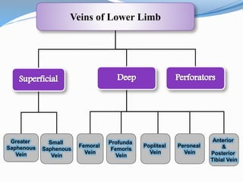
VEINS OF LOWER LIMB

Slide 4
SUPERFICIAL VEINS
They lie in the superficial fascia
They possess many valves along their course
They communicate with deep veins by perforating veins
They consist of:
Dorsal venous arch
Great saphenous vein & its tributaries
Small saphenous vein & its tributaries

Slide 5
SUPERFICIAL VEINS
Dorsal venous arch:
It lies in the superficial fascia of dorsum of foot over the heads of metatarsal bones
Drains on the medial side into great saphenous vein
Drains on the lateral side into small saphenous vein
Receives blood from the foot via digital veins & communicating veins from the sole

Slide 6
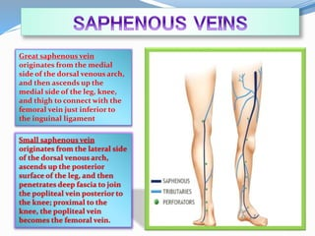
SUPERFICIAL VEINS

Slide 7
SUPERFICIAL VEINS
Great saphenous vein: see front of thigh
Small saphenous vein:
It arises from the lateral end of dorsal venous arch
It ascends in superficial fascia, behind lateral malleolus (with sural nerve)
It ascend in the back of thigh
It pierces deep fascia of the lower part of politeal fossa (between 2 heads of gastrocnemius
It ends in popliteal vein
It receives small veins from the back of leg
It communicates with: deep veins of foot, great saphenous vein

Slide 8
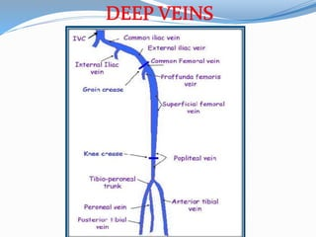
DEEP VEINS

Slide 9
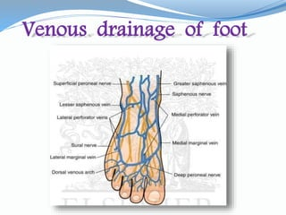
Foot

Slide 10
DEEP VEINS
They consist of:
Venae comitantes to anterior & posterior tibial arteries + their tributaries
Popliteal vein + its tributaries
Femoral vein + its tributaries

Slide 11
PERFORATING VEINS
They are communicating vessels between superficial & deep veins
They are found mainly in region of ankle & medal side of lower part of leg
They possess valves that prevent flow of blood from deep to superficial veins

Slide 12
VARICOSE VEINS OF LOWER LIMB
A condition in which superficial veins of lower limb are elongated & tortuous
Causes:
Weakness of the walls of veins & incompetence of their valves
Incompetence of valves in perforating veins
Lack of power of calf muscles
Treatment: ligation & division of superficial veins

Slide 13
LYMPHATIC DRAINAGE OF LOWER LIMB
Superficial inguinal lymph nodes:
Horizontal group: below ing. Lig.
Medial group: ant. Abd. Wall, perineum,lower ½ anal canal
Lateral group: back
Vertical group: around GSV . Most lower limb
EFFERENTS: thru saphenpous opening into deep inguinal nodes

Slide 14
LYMPHATIC DRAINAGE OF LOWER LIMB
Deep inguinal lymph nodes: beneath deep facia & along medial of femoral vein
Commonly three in number
Efferents from sup. Inguinal nodes & deep structures of lower limb
Efferent pass thru femoral canal into nodes along external iliac artery

Slide 15
LYMPHATIC DRAINAGE OF LOWER LIMB
Popliteal lymph nodes:
They lie in popliteal fossa
They receive lymph from:
knee joint
Deep lymph vessels from leg along anterior & posterior tibial arteries
Some superficial lymph vessels from leg & foot along small saphenous vein
Their efferents drain into deep inguinal lymph nodes

Slide 16
CLINICAL NOTES
LOWER LIMB VENOUS PUMP: contractions of large muscles, adjacent artery pulsations. Sup. Saphenous v
VARICOSE VEINS
GREAT SAPHENOUS CUT-DOWN: ankle and groin
GREAT SAPHENOUS VEIN in Coronary Bypass Surgery

Slide 17
Clinical notes
LOWER LIMB LYMPHATICS:
Lower limb
Skin & sup. Fascia of ant. & post. Abd. Walls below umbilicus
External genitalia
Mucus memb. Of loer ½ of anal canal
Long distances travelled

Slide 18
THANK YOU
ANY QUESTION?

